Slide 1
Gaps in the continuum of care. Loss to follow-up and return to care: Who is at risk?
B.A. Martínez-Guerra, A. Camiro-Zúñiga, Y.N. Caro-Vega, P.F. Belaunzarán-Zamudio, J.G. Sierra-Madero, B.E. Crabtree-Ramírez
Infectious Diseases Department, Instituto Nacional de Ciencias Médicas y Nutrición Salvador Zubirán
Mexico City, Mexico
@BernardoAMarti beramg@gmail.com
No conflict of interest to disclose
Share your thoughts on this presentation with #IAS2019
Notes:
Good afternoon, my name is Bernardo Martínez and on behalf of all the co-authors, I thank the organizers to for giving us the opportunity to present this study. I will present our work titled “Gaps in the continuum of care. Loss to follow-up and return to care: Who is at risk?”
You can see my contact information. I have no conflict of interest to disclose.
The main objective of this work was to identify the factors associated with loss to follow-up and return to care in a cohort of patients from a tertiary center in Mexico City.

Slide 2
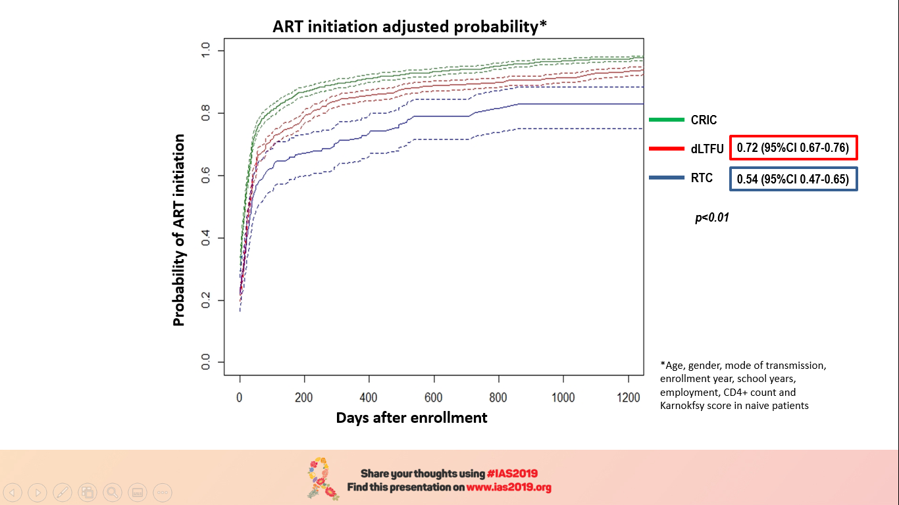
Gaps in the continuum of care. Loss to follow-up and return to care: Who is at risk?
Adjusted* time to ART initiation
n=2,767 enrolled from 2000 to 2017
Constantly-retained in care (CRIC)
Median FU 5.41 (1.86-10.02) yrs
CRIC= 1,746 (63%)
dLTFU= 677 (25%)
RTC= 344 (12%)
Definitively-lost to follow-up (dLTFU)
6.38 (2.93-10.56) yrs*
0.91 (0.12-3.05) yrs*
9.47 (6.02-13.95) yrs*
Returning to-care (RTC)
*p<001
≥1 yr abscence
56% >1 abscence
34% dLTFU
Poorly studied population
Variables at enrollment
Multivariate analysis CRIC as reference | dLTFU HR(95%IC) | p | RTC HR(95%IC) | p
Age | 0.87 (0.77-0.98) | 0.02 | 0.72 (0.62-0.84) | <0.01
Non-sexual T. Mode | 1.88 (1.05-3.37) | 0.03 | 0.37 (0.13-1.04) | 0.06
Enrollment year Enrolled form 2000 to 2004 as reference
2005 to 2008 | 0.62 (0.46-0.84) | <0.01 | 0.32 (0.22-0.46) | <0.01
2009 to 2012 | 0.43 (0.31-0.60) | <0.01 | 0.21 (0.14-0.32) | <0.01
2013 to 2017 | 0.21 (0.15-0.29) | <0.01 | 0.06 (0.04-0.10) | <0.01
No employment | 0.74 (0.58-0.95) | 0.02 | 0.85 (0.63-1.15) | 0.29
CD4+ ≥350 c/uL | 0.87 (0.65-1.16) | 0.33 | 2.53 (1.82-3.52) | <0.01
Treatment naïve | 0.49 (0.38-0.64) | <0.01 | 0.58 (0.42-0.79) | <0.01
No relation: gender, education, socio-economic or conjugal status, AIDS-DC, Karnofsky & initial ART
*Age, gender, mode of transmission, enrollment year, years of education, employment, CD4+ count, and Karnofsky score
*Age, gender, mode of transmission, enrollment year, years of education, employment, CD4+ count, and Karnofsky score in naïve patients
The RTC group participants were frequently LTFU after the first year of care. dLTFU were LTFU earlier in care
Groups with loss to follow-up were less likely to start ART. The RTC group was the least likely to start treatment
Notes:
Gaps in the continuum of care remain a problem. As we strive to reach de 90 90 90 goal, we must continue our effort to improve retention in care, which is a challenge and complex to achieve.
We divided our cohort in three groups, those continuously retained in care (they had at least a clinical visit within a 365 days period), those definitely lost to follow-up (those who at some point in time stopped their clinical and antiretroviral supply visits) and those returning to care after an initial loss to follow-up episode of at least a year (meaning that during at least a year they did not attend clinical or drug supply visits). The latter group (represented in blue) is of special interest as it has been a poorly studied population so far.
2,767 adult patients enrolled from 2000 to 2017 were included. The overall median follow-up was 5.4 years.
63% belonged to the continuously retained in care group, 25% were classified as definitely lost to follow-up and 12% were grouped as those returning to care.
The median follow-up time between the groups showed significant differences.
We observed that 56% of the returning to care group presented at least one additional episode of loss to follow-up, and eventually, 34% of those returning to care presented a definitive lost to follow-up.
We registered demographic and clinical variables at enrollment. Considering the continuously retained in care group as a reference, important differences were observed between the 3 groups in the multivariate analysis.
Loss to follow up groups were more likely to be enrolled at younger ages. They were less likely to be treatment naïve. Additionally, taking the patients enrolled from 2000 to 2004 as reference, the probability of belonging to any of the LTFU groups decreased through time.
Patients in the definitely lost to follow up group were more likely to report a non-sexual transmission mode as well as employment.
Interestingly, the returning to care group patients were more likely to be enrolled with higher CD4 cell counts. No differences according to other variables, including initial ART regimen, were observed.
In the first graph, you can see the adjusted probability for remaining in care, which was different between the two loss to follow-up groups. The returning to care group participants were frequently lost to follow-up after one year in care, whereas the definitely lost to follow-up group were lost earlier in care (the median time to LTFU was less than a year in the latter group). The difference between groups was significant.
According to the second graph, considering only naïve patients and taking those retained in care group as a reference, a lower adjusted probability of antiretroviral treatment initiation was observed in both loss to follow-up groups, being those returning to care the least likely to initiate treatment.
Treatment initiation took longer in both LTFU groups.

Slide 3
Take home messages
The CRIC, dLTFU and RTC groups are different
The RTC group participants were likely to present subsequent loss to follow-up episodes (34% of them were eventually definitely lost to follow-up!)
Special retention strategies should be implemented
Time to treatment initiation was longer in the loss to follow-up groups
Reinforce early treatment
A higher CD4+ cell count was associated with RTC
Are they feeling better and abandon care because of it?
More research is needed
Notes:
According to our findings we can conclude that the CRIC, the definitely lost to follow-up and the returning to care groups were different.
Those lost and returning to care, presented high rates of subsequent loss to follow-up and a third of them (34%) eventually was definitely lost to follow-up. This group of patients should be closely followed and differentiated, special strategies should be implemented.
Both lost to follow-up groups were less likely to start antiretroviral treatment, which might reinforce the already proven benefit of early antiretroviral start; albeit, further research is needed in these different groups of care. We believe that early treatment initiation might act as a protective factor for LTFU.
Interestingly, a higher CD4 cell count at enrollment was more frequently observed in those lost to follow up and returning to care. Could it be that these patients are feeling better and abandon care because of it?
Again, as further research is warranted, retention strategies must be implemented.
Thank you again, I’ll be happy to take any questions.

Slide 4
Acknowledgments
HIV clinic personnel
ID residents team
Patients and their families

